Slide 1
Escape Room – Python project

Slide 2

Concepts used
Functions
Loops
Dictionaries
Operation times / Sleep command

Slide 3
Improvements
List organization
Narrative
Game control

Slide 4
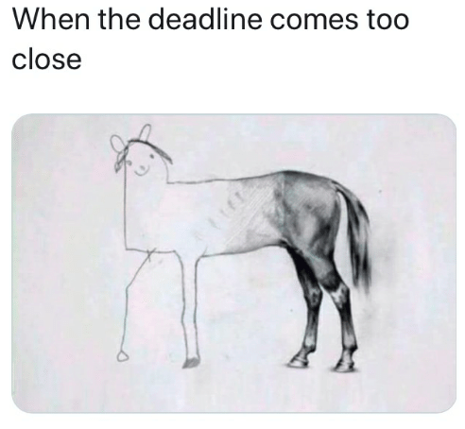
Room for improvement
Use of object oriented programming
Visual improvements

